Slide 1
Pi Pico OOP Mini Project
Ben Jones
Tempe High School
Lecture 0

Slide 2
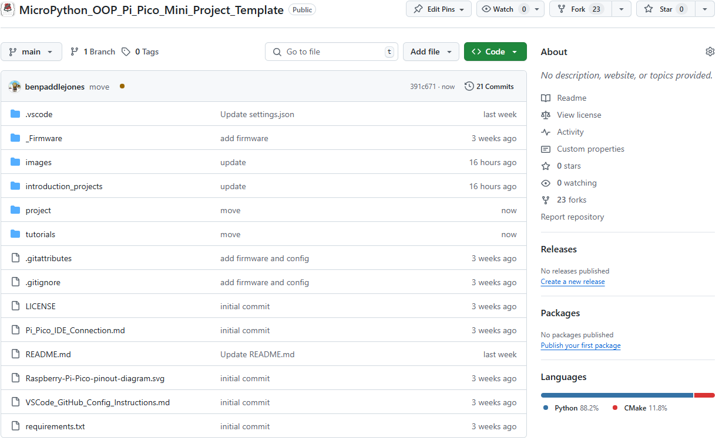
Fork Repo
Pi Pico Firmware
Instructions for
Introduction Projects
VSCode Project Folder
Preconfigured for Pi Pico Extension
Text Instructions for
OOP Mini Project
Pi Pico IDE Connection

Slide 3
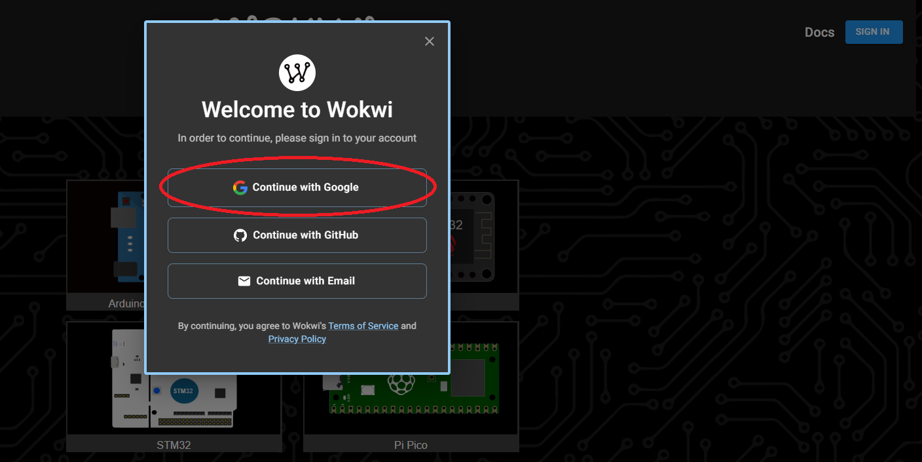
Wokwi

Slide 4
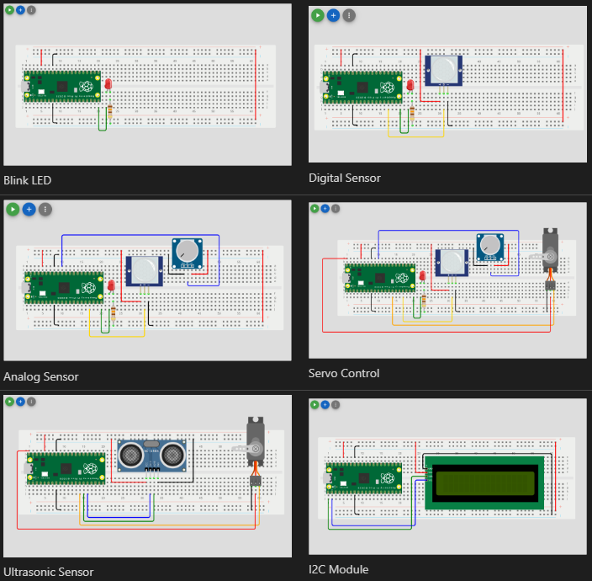
Introduction Projects

Slide 5
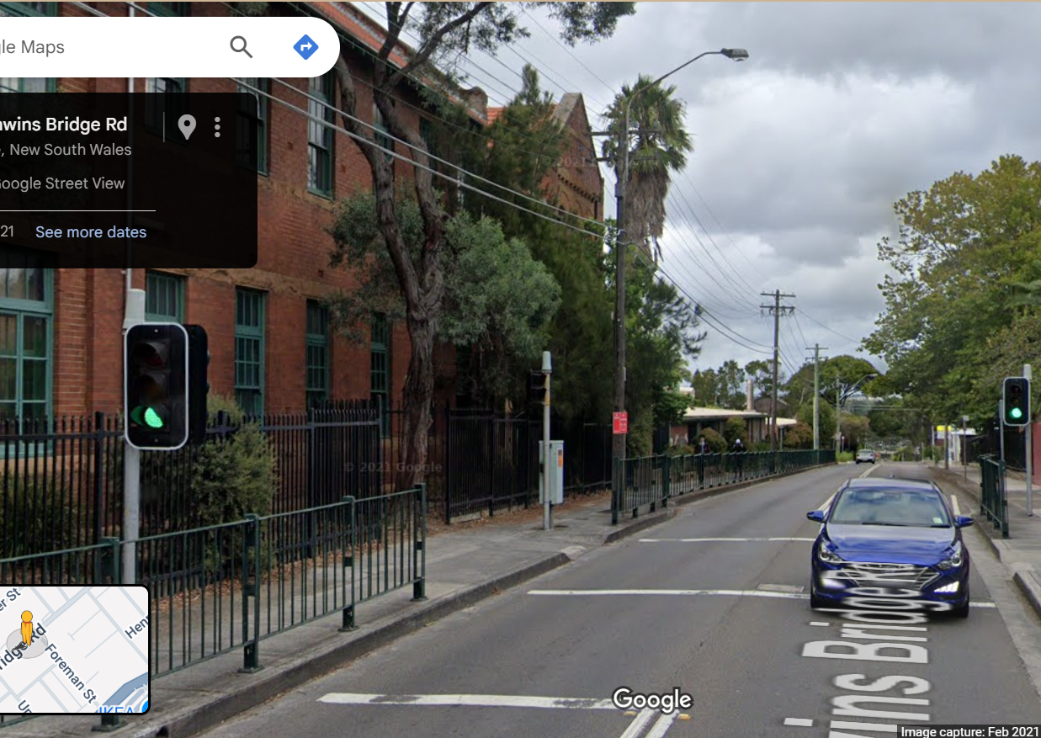
Simple Open Loop Control System
Traffic Lights remain green until pressed (idle state).
Button pressed triggers state change.
Lights rotate through a pattern based on time.
System returns to idle state.
Can you see the controller?

Slide 7
IDE
Wokwi
Arduino Lab Web Based IDE
Thonny
VSCode
Codespaces
Note:
This repository is optimised for VSCode.
I will Model both VSCode & Wokwi in this series.
See Pi_Pico_IDE_Connection.md for help with IDE’s and connection.

Slide 8
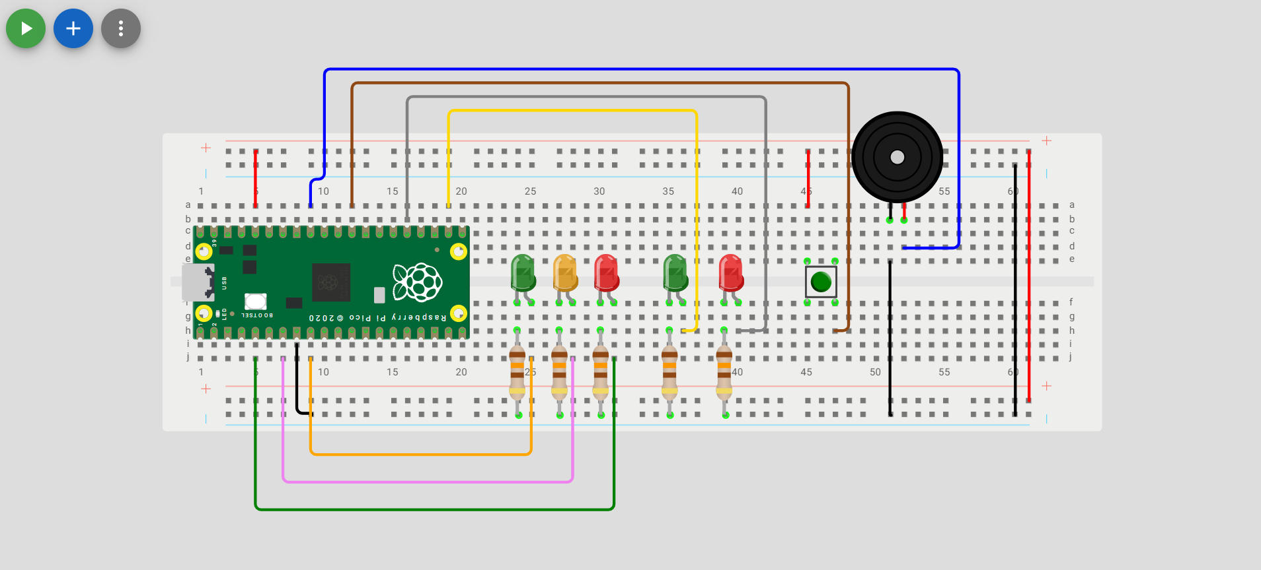
Wokwi Prototype
Unit Tests
All 5 LEDs should illuminate.
The buzzer should emit animated musical note on screen and if volume is turned up a constant tone.
The momentary switch should return `1` to the IDE terminal when closed (pressed) and 0 when not closed (depressed).
Run: v02.py

Slide 9
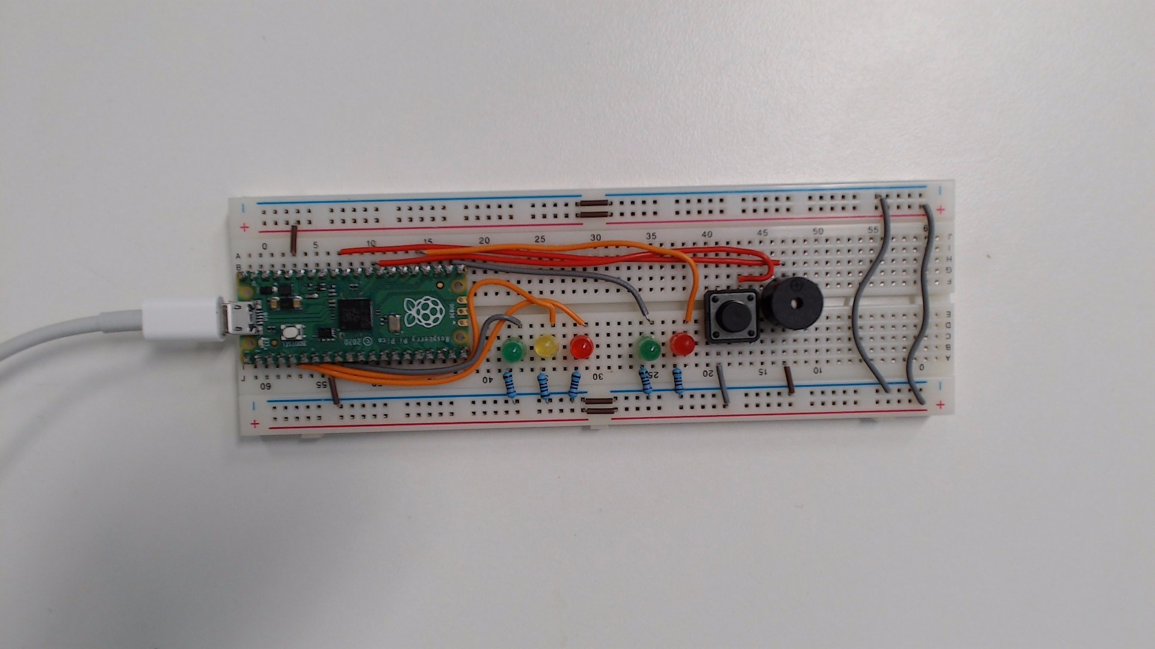
Physical Prototype
Unit Tests
All 5 LEDs should illuminate.
The buzzer should emit a constant tone.
The momentary switch should return `1` to the IDE terminal when closed (pressed) and 0 when not closed (depressed).
Run: v02.py

